Slide 1


Hotel Booking System - Project Report
Submitted BY :
709 : Yanshu Dankhara
734 : Het Maniya
744 : Avadh Narola
Guided BY :
Viral B Polishvala

Slide 2

CONTENTS
Introduction
2. Project Profile
3. Core Objectives
4. System Architecture: User & Admin Panels
5. User Panel Features
6. Admin Panel Features
7. System Flow Diagrams
8. Data Flow Diagram
9. E-R Diagram
10. Database Design
11. System Design Screenshots
12. References

Slide 3
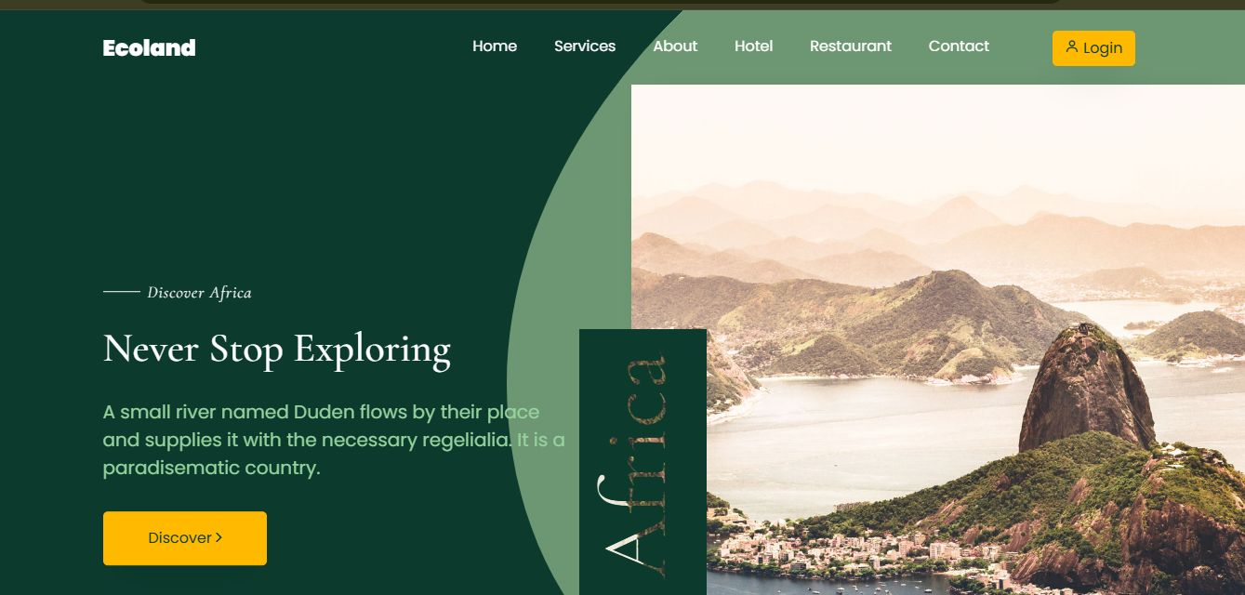
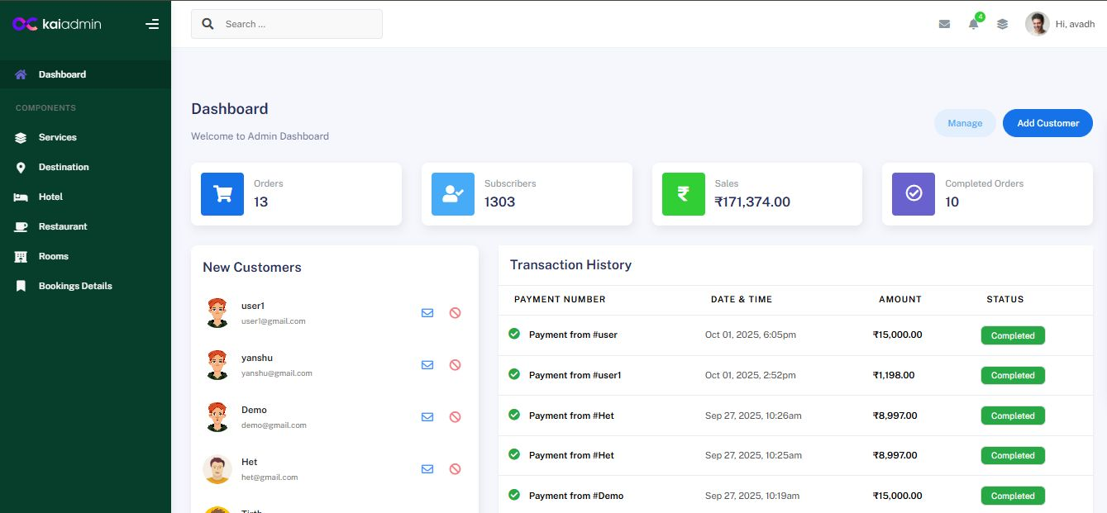
1. Introduction
Project Description
The Hotel Booking Website is a user-friendly online platform designed to simplify searching, comparing, and reserving hotel accommodations. It provides customers a seamless experience to browse available rooms, view amenities, check prices, and make bookings easily. The system bridges the gap between hotels and guests with an interactive interface ensuring transparency, reliability, and ease of use. It caters to a wide range of preferences, from budget-friendly stays to luxury accommodations.

Slide 4







2. Project Profile
Technical Specifications
Project Title
Frontend
Backend
Platform
Hotel Booking System
HTML, CSS3, JavaScript
PHP, MYSQL
VS Code
Supported Browsers
Documentation Tool
Internal Guide
Chrome, Edge
MS Word
Viral B Polishvala

Slide 5











3. Core Objectives
1
2
Simplify Hotel Search
User-Friendly Booking
Allow users to easily search for hotels based on location, price, services, and availability.
Provide a simple and secure booking flow for customers.
3
4
Transparency
Efficient Admin Management
Display accurate details about rooms, services, pricing, and availability.
Enable administrators to manage room listings, services, and reservations efficiently.
5
6
Accessibility & Security
Automation
Ensure the system is accessible anytime via a responsive design and that customer data is handled safely.
Reduce manual work for customers and hotel staff by automating the booking process.

Slide 6
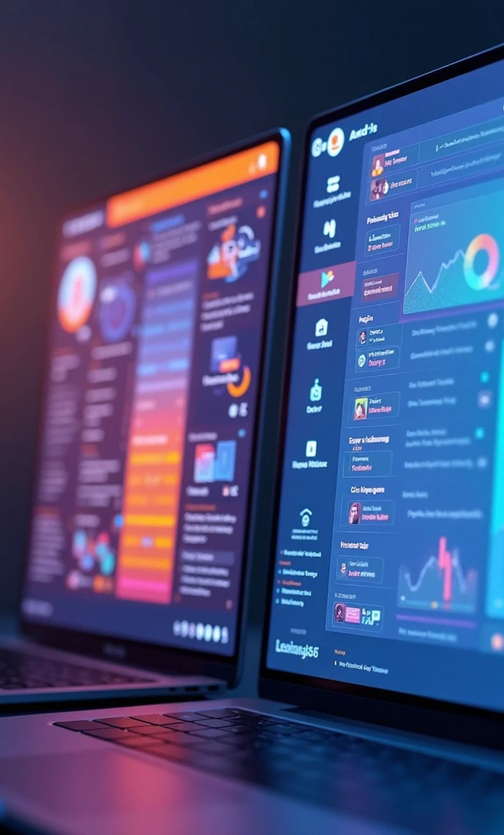
4. System Architecture: User & Admin Panels
The system is divided into two main modules:

Slide 7
User Panel
Designed for customers to search, view, and book hotels. Features include user registration, profile management, hotel search with filters, booking management, and providing feedback.
Admin Panel
Designed for hotel administrators to manage the platform's content and operations. Features include a secure login, dashboard with statistics, and management of hotels, services, bookings, and users.

Slide 8
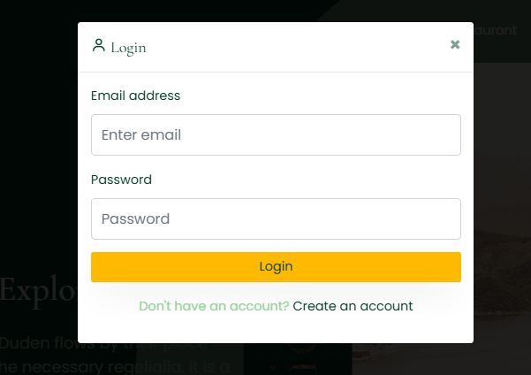


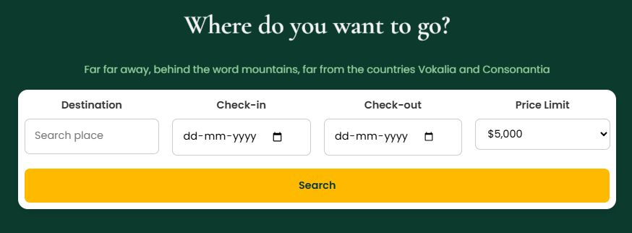

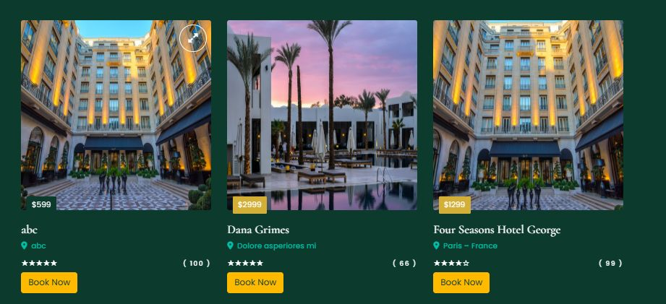
5. User Panel Features
Part 1
User Registration & Login
Create a new account with personal details. Secure login using email and password. Profile management to update personal details.
Hotel Search & Filter
Search hotels by name, location, or category. Apply filters like price range, amenities (WiFi, pool), room type, and ratings.
Hotel & Room Details
View complete information about hotels, including descriptions, images, and services.

Slide 9
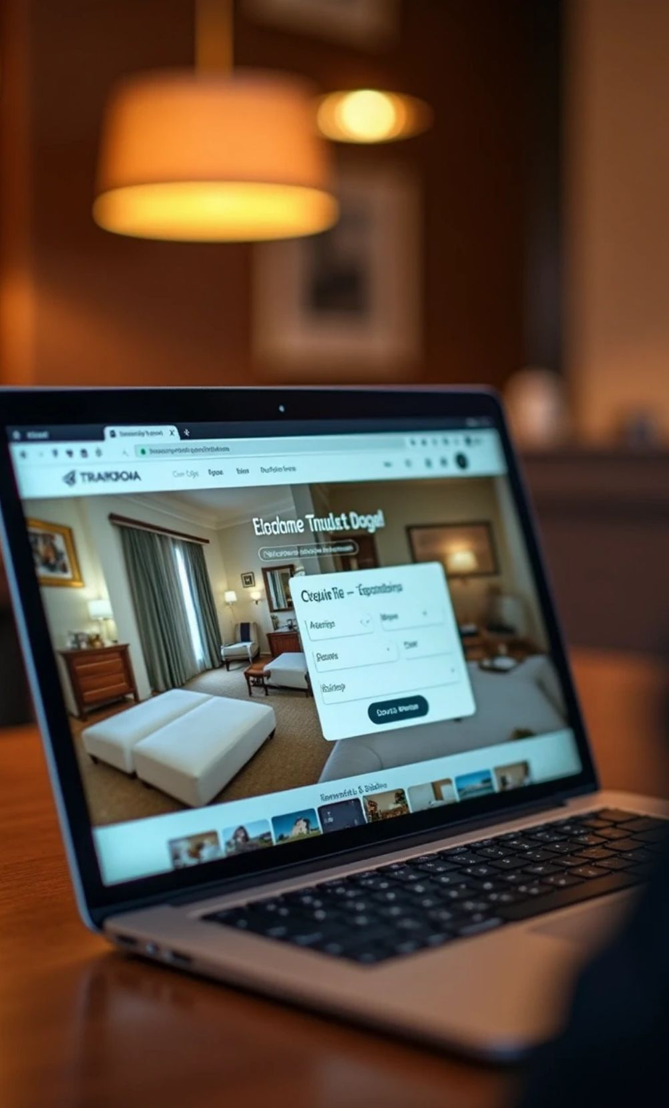





Part 2
1
Booking Management
Book selected rooms in simple steps. View a booking summary before confirmation. Receive on-screen booking confirmation via an Alert Message.
2
My Bookings
A dedicated section to view all past and upcoming reservations.
3
Payment & Feedback
Secure payment gateway for online transactions. View payment status (paid or unpaid) in "My Bookings". Option to provide feedback and reviews for hotels.

Slide 10



6. Admin Panel Features
Part 1
Part 2
• Admin Login & Dashboard: Secure login system for administrators. Dashboard provides an overview of total hotels, rooms, bookings, and users. Displays quick statistics on available rooms and revenue.
• Service Management: Add or update services such as WiFi, swimming pool, and parking. Enable or disable services for specific rooms or hotels.
• Booking Management: View all customer bookings with details. Approve, modify, or cancel reservations as needed.
• Hotel Management: Add new hotels with complete details (name, address, images, price). Edit, update, or delete existing hotel information.
• User Management: View a list of registered users and their booking history. Handle user queries and complaints.

Slide 11

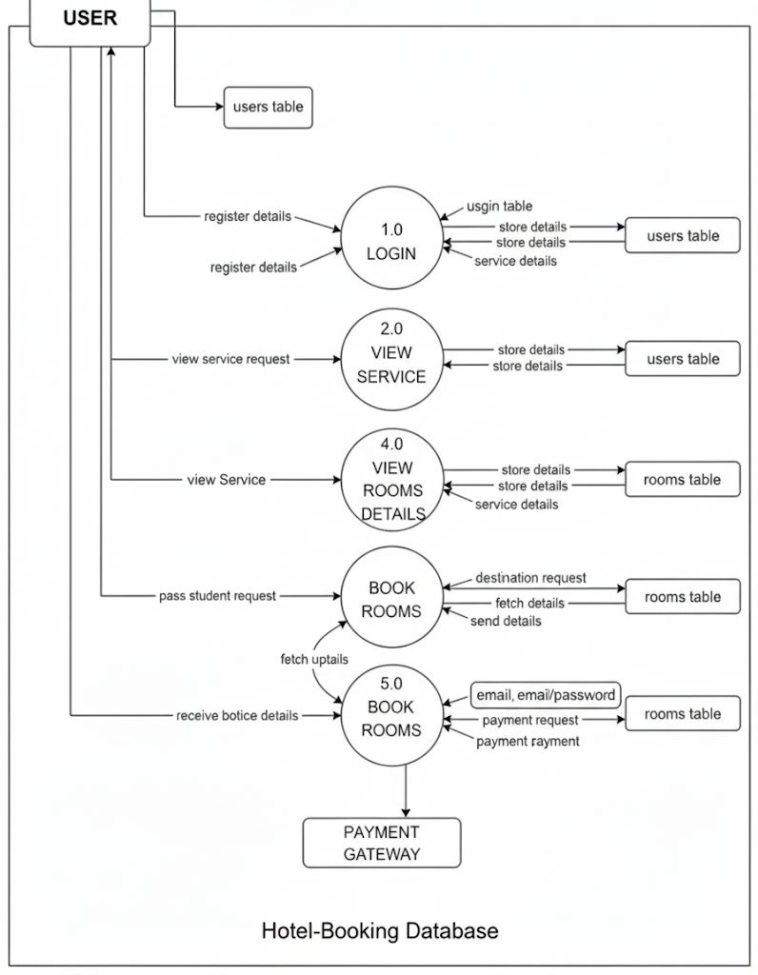
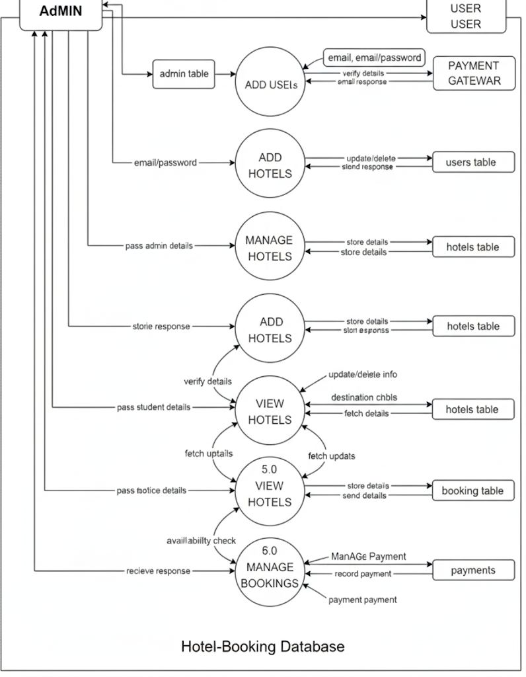
7. System Flow Diagrams
Admin Process :
User Process :
User signs up or logs in. Searches for hotels and applies filters. Views hotel and room details.
Selects a room and proceeds to payment. Receives booking confirmation upon successful payment. Can view or cancel bookings in the "My Bookings" section.
Admin logs into the secure system. Upon successful login, the admin is directed to the dashboard. From the dashboard, the admin can add, update, or delete hotels, manage all hotel listings, and view transactions and revenue.

Slide 12
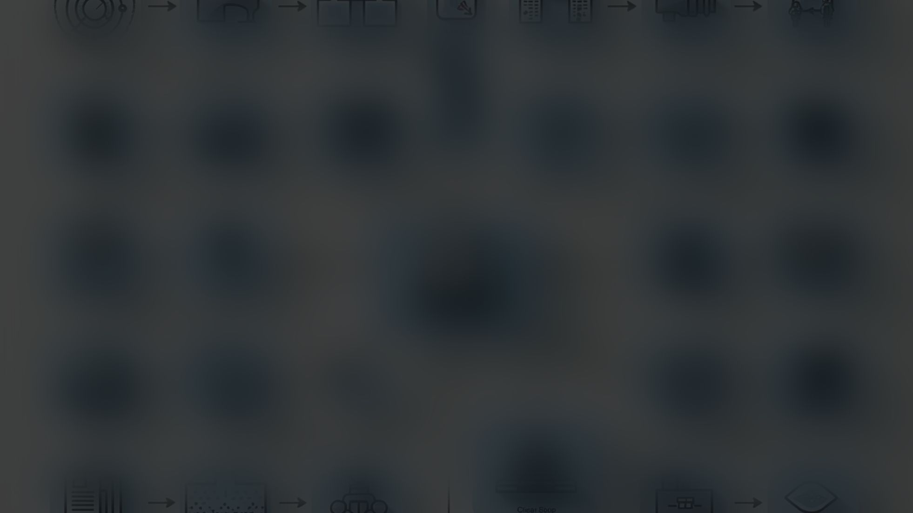
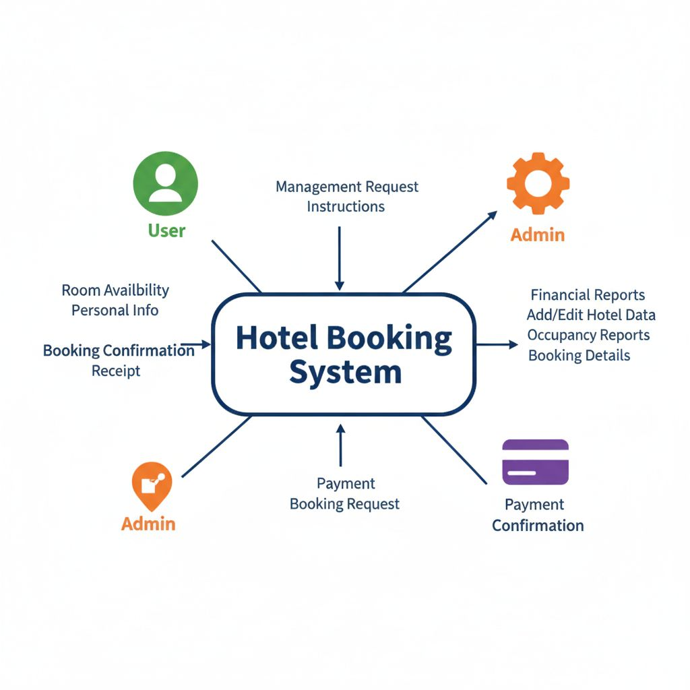





8. Data Flow Diagram
DFD Level 0 (Context Diagram)
Overview:
This diagram shows the entire Hotel Booking System as a single process.
External Entities
User Inputs
User and Admin.
Personal info, search queries, booking requests.
User Outputs
Room availability, booking confirmation, receipts.
Admin Inputs
Admin Outputs
Management requests, hotel data.
Financial reports, occupancy reports.

Slide 13



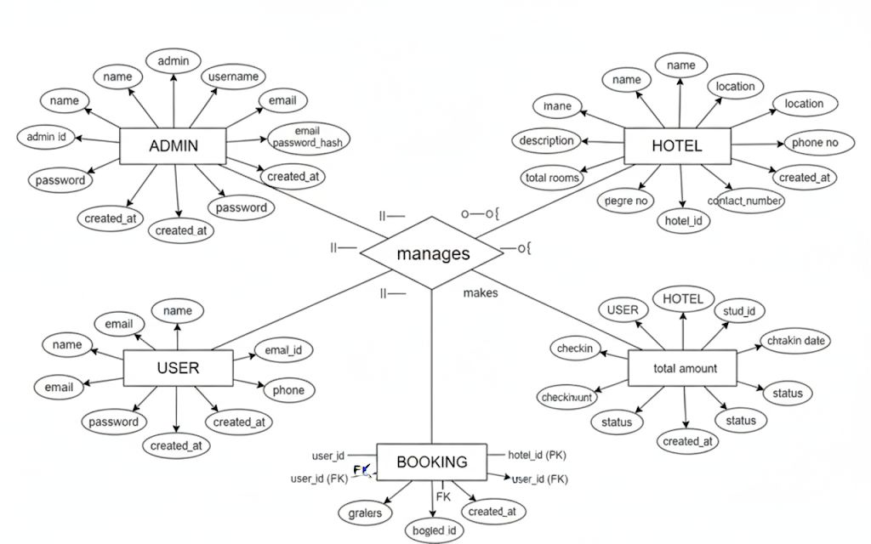






1
9. E-R Diagram
ADMIN
Manages the system.
2
USER
Makes bookings.
3
HOTEL
Contains details like name, location, and rooms.
4
BOOKING
A central entity linking a USER to a HOTEL, containing details like check-in/out dates and status, and how a User makes a Booking for a Hotel.

Slide 14
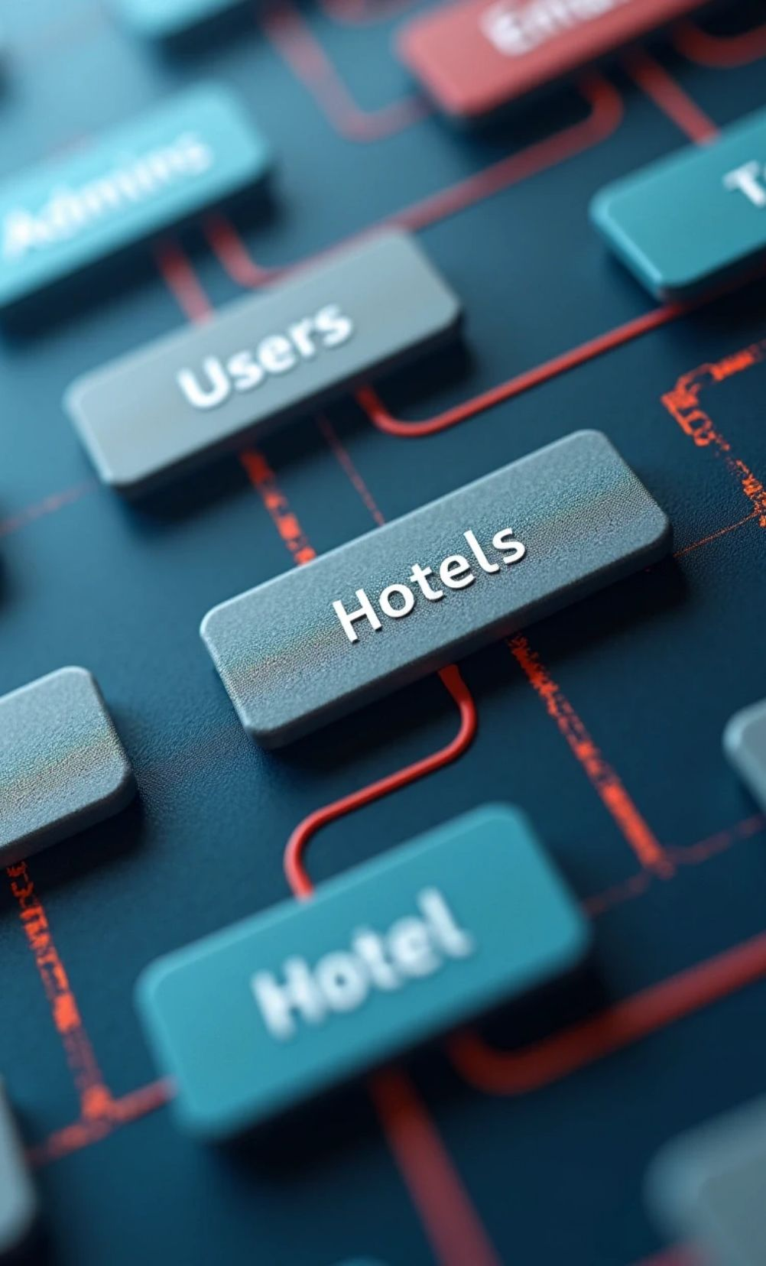




10. Database Design
Core Tables
Admins Table
Users Table
Stores admin credentials. Fields: id, name, email, password.
Stores user information. Fields: id, fullname, email, password.
Hotels Table
HotelBookings Table
Stores details of each hotel. Fields: id, name, price, description, service.
Stores booking transaction details. Fields: id, user_id (FK), hotel_id (FK), checkin_date, payment_status.

Slide 15
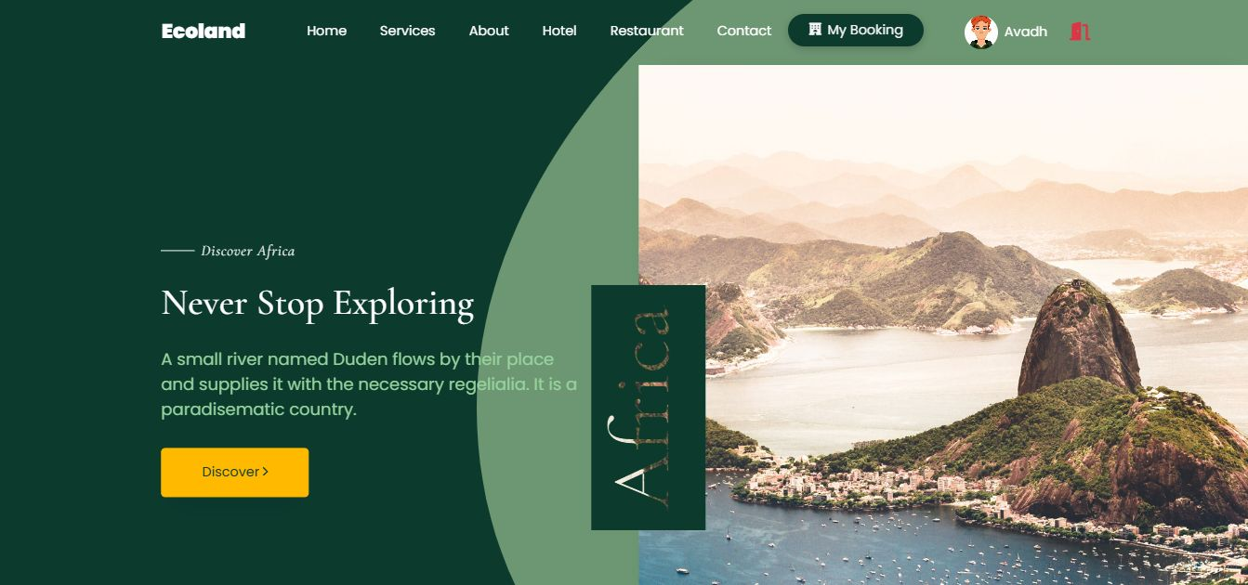
11. System Design Screenshots
Homepage & Login
User Interface: A clean and modern homepage (Index.php) with navigation links. Prominent "Login" button that opens a modal for user authentication. Option for new users to navigate to the registration form.

Slide 16

Hotel Search & Booking
Booking Process: After logging in, users can access the search functionality with filters for Destination, Check-in/Check-out dates, and Price Limit. Users can view hotel listings and click “Search". The hotel detail page shows amenities, price, and a form to finalize the booking dates and number of guests.

Slide 17
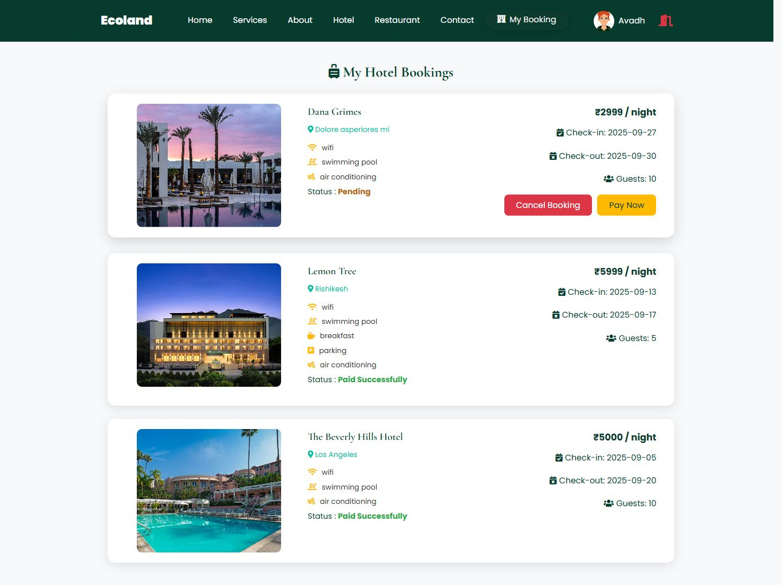
My Bookings & Payment
Post-Booking: After a booking is confirmed, it appears in the "My Hotel Bookings" section with its status (e.g., Pending).
Users have options to "Cancel Booking" or "Pay Now".
The payment page offers secure options, including QR code scan and credit card payment, to complete the transaction.
Once paid, the booking status updates to "Paid Successfully".

Slide 18
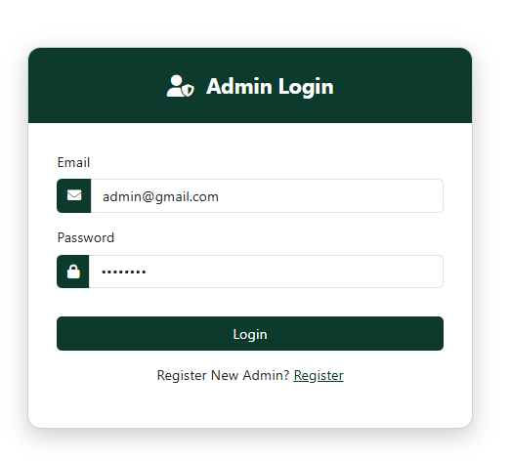
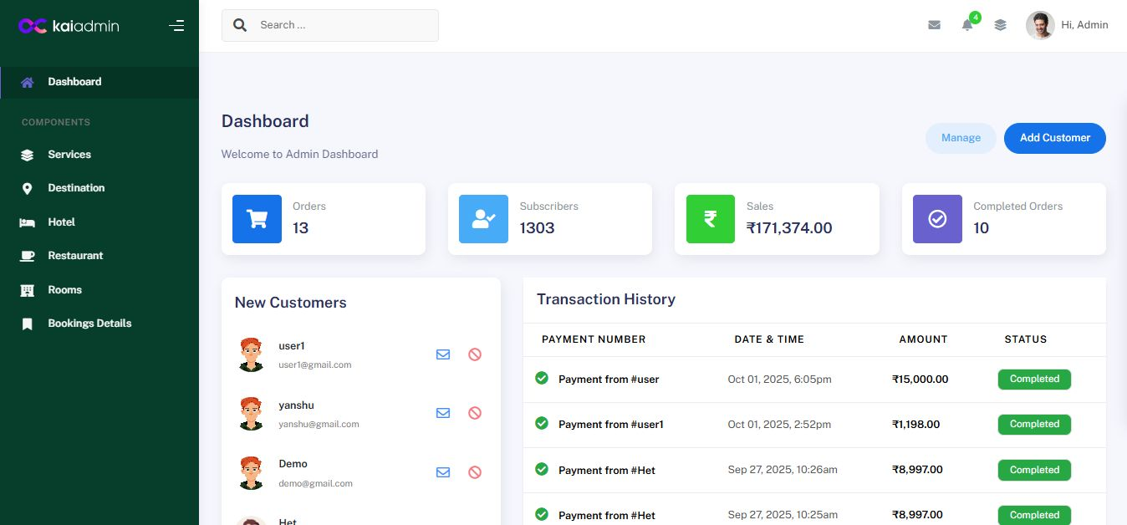
Admin Login & Dashboard
Admin Interface: A dedicated and secure login page for administrators. The main dashboard provides a comprehensive overview of key metrics: Number of Orders/Bookings, Subscribers/Users, Total Revenue, List of New Customers, Recent Transaction History.

Slide 19
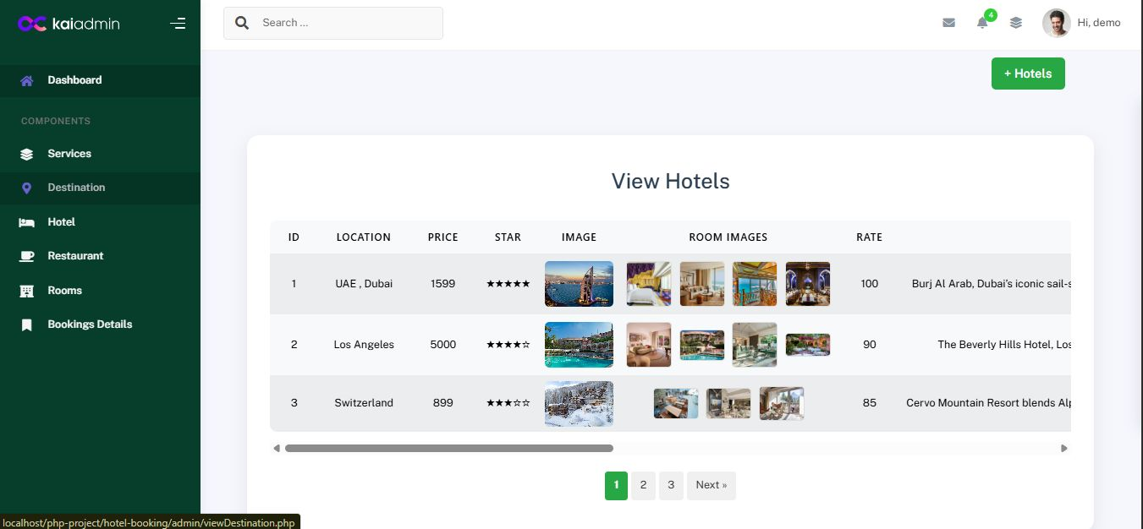
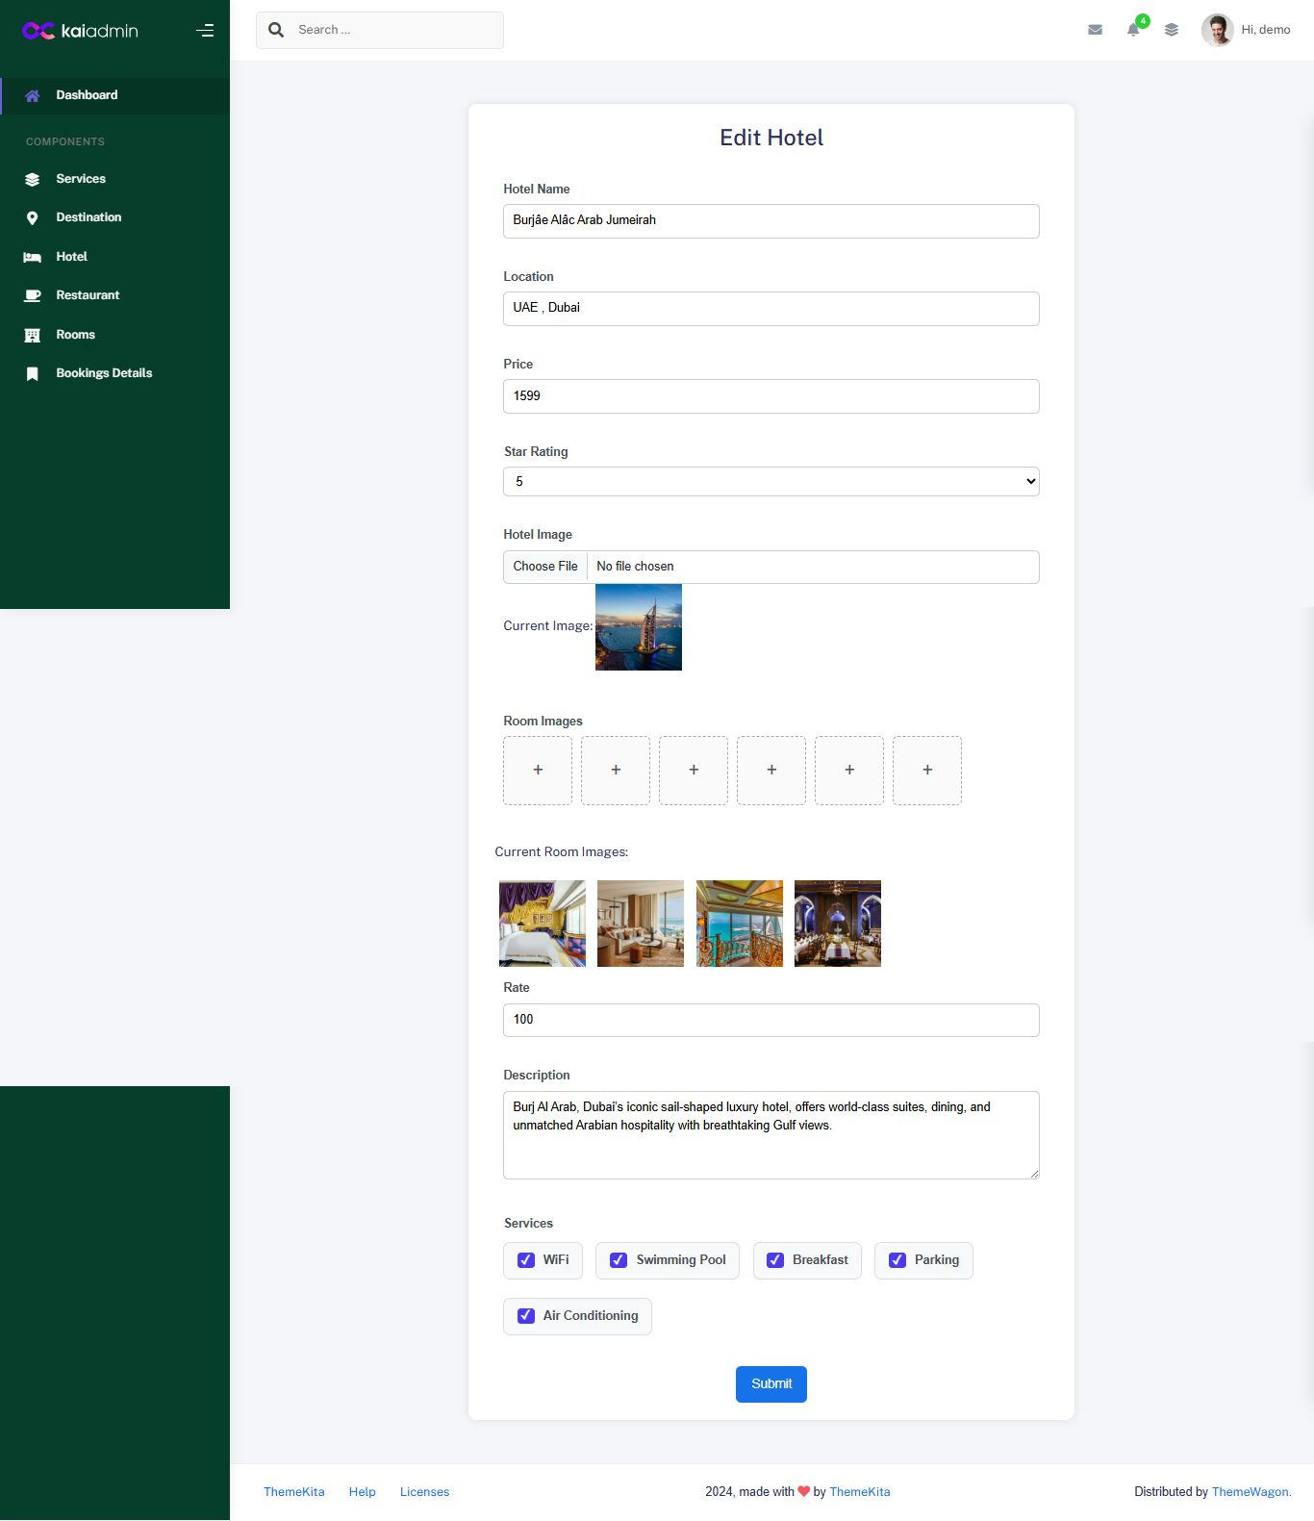
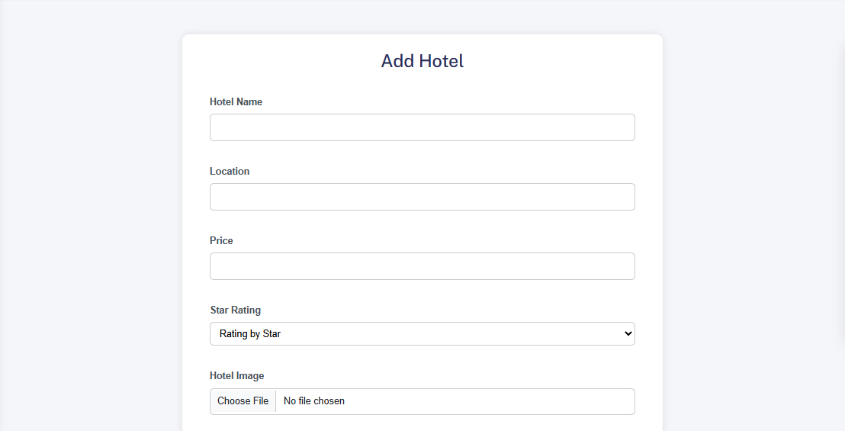
Admin Management
Management Capabilities: Admins can view, edit, and delete services offered by hotels. Admins can view a detailed list of all bookings, including user name, hotel, check-in/out dates, and payment status. Functionality to search and filter through records is provided for efficient management. Admins have the ability to delete bookings directly from the "Booking Details" page.

Slide 20




12. References
w3schools.com
dribbble.com
github.com
tutorialspoint.com
php.net
geeksforgeeks.org
Thank You.

